Slide 1
Introduction to data warehousing
MTN.BI.07
Star Schema Basics
Elias Nema
Lead Software Engineer
Elias_Nema@epam.com

Slide 2



Enterprise
I store this on my laptop
Our server is down
Everything is OK
Forgot password
I want to make an order
Sales are up

Slide 3
Data Warehouse
Executives looking for enterprise-wide answers to corporate questions had no place to go (on their own) to get answers or even just to look around.
Here when Data Warehouses came into the game.

Slide 4
Agenda
The Dimensional Data Model
Star Schema
SnowFlake

Slide 5
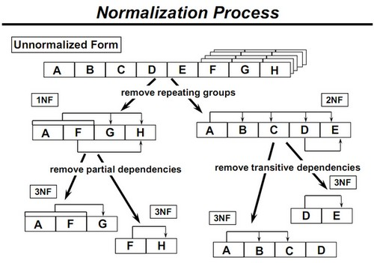
Normalization ↔ Denormalization

Slide 6

Denormalization (Star)
Fact tables in star schema are mostly in third normal form (3NF)
Dimensional tables are mostly in denormalized zero normal form (0NF)
Single table for each dimension

Slide 7

Normalization (Snowflake)
The snowflake schema is a more complex schema than the star schema because the tables which describe the dimensions are normalized
Typically contains multiple tables per dimension
Each table contains dimension key, value, and the foreign key value for the parent

Slide 8
The Dimensional Data Model

Slide 9
Why Dimensional?
Deliver data that’s understandable to the business users.
Deliver fast query performance.

Slide 10
Benefits
Dimensional modeling is a longstanding technique for making databases simple.
In case after case, for more than five decades, IT organizations, consultants, and business users have naturally gravitated to a simple dimensional structure to match the fundamental human need for simplicity.
Simplicity is critical because it ensures that users can easily understand the data, as well as allows software to navigate and deliver results quickly and efficiently.

Slide 11
OLTP and Analytical
An OLTP system must specialize in managing rapidly changing data and keeping it safe. OLTP systems must track millions of separate transactions per day and encourage a usage style that peppers the database with tiny atomic processing requests that are all very similar. An OLTP transaction rarely uses a join.
Conversely, a data warehouse system must specialize in managing huge static sets of data copied from production OLTP systems and process them into small answer sets.

Slide 12
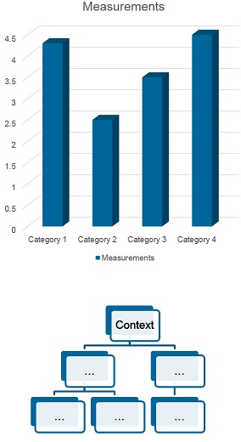
Measurement and Context
Dimensional modeling begins by dividing the world into measurements and context.
Measurements are usually numeric and taken repeatedly. Numeric measurements are facts.
By contrast, the context surrounding the facts is open ended and verbose. It is not uncommon for the designer to add context to a set of facts partway through the implementation.

Slide 13

A Star is Born
A dimensional design for a relational database is called a star schema. Related dimensions are grouped as columns in dimension tables, and the facts are stored as columns in a fact table. The star schema gets its name from its appearance: when drawn with the fact table in the center, it looks like a star or asterisk.

Slide 14
Facts and Dimensions
The fact table stores the performance measurements resulting from an organization’s business process events.
Measurement data is overwhelmingly the largest set of data.
Allowing business users from multiple organizations to access a single centralized repository for each set of measurement data ensures the use of consistent data throughout the enterprise.
Dimension tables are integral companions to a fact table.
The dimension tables contain the textual context associated with a business process. They describe the “who, what, where, when, how, and why” associated with the event.
Dimension tables often have many columns or attributes. It is not uncommon for a dimension table to have 50 to 100 attributes; although, some dimension tables naturally have only a handful of attributes.

Slide 15
Additivity
The most useful facts are numeric and additive, such as dollar sales amount.
Additivity is crucial because BI applications rarely retrieve a single fact table row. Rather, they bring back hundreds, thousands, or even millions of fact rows at a time, and the most useful thing to do with so many rows is to add them up.
Semi-additive facts, such as account balances, cannot be summed across the time dimension.
Non-additive facts, such as unit prices, can never be added.

Slide 16
Facts' FKs, Dimensions' PKs
All fact tables have two or more foreign keys that connect to the dimension tables’ primary keys. For example, the product key in the fact table always matches a specific product key in the product dimension table.
The fact table generally has its own primary key composed of a subset of the foreign keys. This key is often called a composite key.

Slide 17
Dimension Tables
WHAT?
Defined by a single primary key
WHO?
Many Attributes (50, 100 columns and many more)
Sale
WHEN?
Minimum codes, maximum descriptions
HOW?
WHERE?
Fewer rows than fact tables

Slide 18
Dimensions are REALLY IMPORTANT!
In many ways, the data warehouse is only as good as the dimension attributes.
The analytic power of the DW/BI environment is directly proportional to the quality and depth of the dimension attributes.

Slide 19
Star schema

Slide 20
Star Schema
StoreDim
Each business process is represented by a dimensional model that consists of a fact table containing the event’s numeric measurements surrounded by a halo of dimension tables that contain the textual context that was true at the moment the event occurred.
PromotionDim
RetailSales
Date Key
Product Key
Store Key
Promotion Key
Customer Key
Transaction#
Sales Dollars
Sales Units
DateDim
CusomerDim
ProductDim

Slide 21
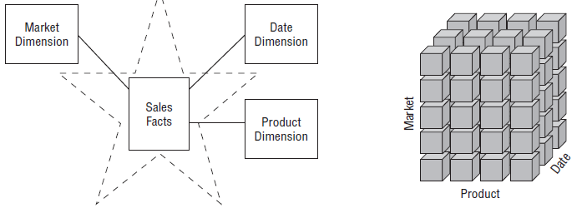
Star Schemas versus OLAP Cubes
If your DW/BI environment includes either star schemas or OLAP cubes, it leverages dimensional concepts.
Cubes provide superior query performance because of precalculations, but pays a load performance price.
Both stars and cubes have a common logical design with recognizable dimensions; however, the physical implementation differs.

Slide 22
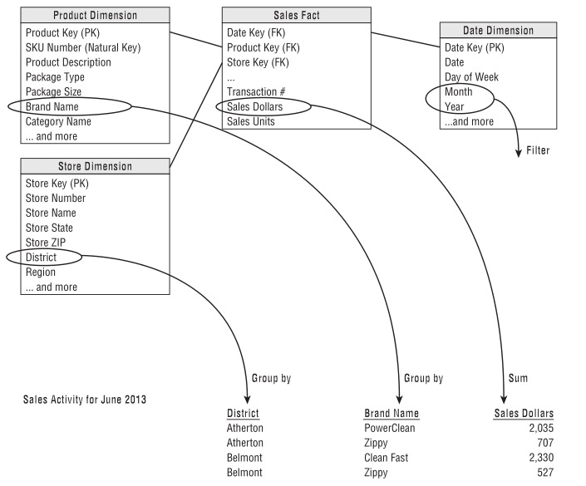
Translating Star Model to a Report

Slide 23
snowflake

Slide 24
Snowflake
RegionDim
StoreDim
YearDim
MonthDim
PromotionDim
RetailSales
Date Key
Product Key
Store Key
Promotion Key
Customer Key
Transaction#
Sales Dollars
Sales Units
DateDim
"Snowflaking" is a method of normalizing the dimension tables in a star schema.
CusomerDim
ProductDim
CategoryDim
ProductTypeDim

Slide 25
When can/need I use a snowflake?
Usually answer is that it is a bad idea to expose the users to a physical snowflake design because it usually compromises understandability and performance.
Nevertheless, in certain situations a snowflake design is not only acceptable, but also recommended.

Slide 26
4 Step Dimensional Process
Step 1: Select the Business Process
Step 2: Declare the Grain
Step 3: Identify the Dimensions
Step 4: Identify the Facts

Slide 27
Business Process
Business processes are the operational activities performed by your organization.
Business process events generate or capture performance metrics that translate into facts in a fact table. Most fact tables focus on the results of a single business process.
Choosing the process is important because it defines a specific design target and allows the grain, dimensions, and facts to be declared.

Slide 28
Grain
Declaring the grain is the pivotal step in a dimensional design.
The grain establishes exactly what a single fact table row represents.
The grain must be declared before choosing dimensions or facts because every candidate dimension or fact must be consistent with the grain.
Atomic grain refers to the lowest level at which data is captured by a given business process.
Each proposed fact table grain results in a separate physical table; different grains must not be mixed in the same fact table.

Slide 29
Dimensions
Dimensions provide the “who, what, where, when, why, and how” context surrounding a business process event.
Dimension tables contain the descriptive attributes used by BI applications for filtering and grouping the facts. With the grain of a fact table firmly in mind, all the possible dimensions can be identified.
Dimension should be single valued when associated with a given fact row.

Slide 30
Facts
Facts are the measurements that result from a business process event and are almost always numeric.
A single fact table row has a one-to-one relationship to a measurement event as described by the fact table’s grain. Thus a fact table corresponds to a physical observable event, and not to the demands of a particular report.
Within a fact table, only facts consistent with the declared grain are allowed. For example, in a retail sales transaction, the quantity of a product sold and its extended price are good facts, whereas the store manager’s salary is disallowed.

Slide 31
Star Schema Basics
Elias Nema
Lead Software Engineer
Elias_Nema@epam.com

